Slide 1

E-Commerce Website
AmazingOnlineShop

Slide 2

00
Branch :- Master of Computer Application
Sem :- IV
Subject :- Software Project
Code :- 649401

Slide 3
Amazing online shop
SUBMITTED BY
Students of MCA SEM IV
SUBMITTED TO
R.B. institute of management Studies

Slide 4
NO | ENROLLMENT NO | NAME
1 | 225490694039 | Rupesh Jadhav
2 | 225490694040 | Mohit Jain
3 | 225490694087 | Kashyap Prajapati

Slide 5
Index
1. Introduction
1.1. Existing System
1.2. Need for the New System
1.3. Objective of the New System
1.4. Problem Definition
1.5. Core Components
1.6. Project Profile
1.7. Assumptions and Constraints
1.8. Advantages and Limitations of the Proposed System
2. Requirement Determination & Analysis
2.1. Requirement Determination
2.2. Targeted Users
3. System Design
3.1. Use Case Diagram
3.2. Class Diagram
3.3. Interaction Diagram
3.4. Activity Diagram
3.5. Data Dictionary
4. Screenshots of main modules

Slide 6
Introduction
The exchange of Goods and services for money
Buyers :- these are people with money who want to purchase a good or service.
Seller :- these are the people who offers goods and services to buyers.

Slide 7
Existing System
The current system for shopping is to visit the shop manually and from the available product choose the item customer want and buying the item by payment of the price of the item .
It is less user-friendly.
User must go to shop and select products.
It is difficult to identify the required product.
Description of the product limited
It is a time consuming process.
Not in reach of distant users.

Slide 8
Need for the New System
In the new system customer need not go to the shop for buying the products. He can order the product he wish to buy through the application in his Smartphone.
The shop owner will be admin of the system. Shop owner can appoint moderators who will help owner in managing the customers and product orders. The system also recommends a home delivery system for the purchased products.

Slide 9
Objective of the New System
Our product will be the online shopping items with online Quiz Draw.
Our website will be product based service.
We are using B2C type of business model.
B2C means business to customer model where the companies will be selling their goods to the customers directly using our services.

Slide 10
Advantages and Limitations of the Proposed System
Online shopping provides access to a vast range of products from various sellers and brands. Shoppers can easily compare prices, read product reviews, and find unique or niche items that may not be available in local stores.
Online shopping saves time and effort by eliminating the need for travel, parking, and waiting in queues. It also allows shoppers to compare prices easily, find discounts, and take advantage of exclusive online deals, leading to potential cost savings.
Online retailers typically offer home delivery services, bringing purchased items directly to the customer's doorstep. Delivery tracking systems allow customers to monitor the progress of their shipments and plan accordingly.

Slide 11
Project Profile
Explore a vast assortment of products across multiple categories. Effortless search and filtering: Quickly find what you need with our intuitive search and filtering options.
Secure transactions: Shop with confidence using our secure payment gateways.
Experience fast and reliable delivery straight to your door step.
Thrilling prize giveaways: Every purchase earns you an entry into our exciting prize draws.
Personalized recommendations: Discover tailored product suggestions based on your preferences.
User-friendly interface: Enjoy seamless navigation with our intuitive app design.

Slide 12
Our website will be having two types of users.
Core Components
CUSTOMER
Admin

Slide 13
WHAT CUSTOMER’S CAN DO
Customers can order the product.
Customers can see the descriptions of the products.
For buying/ordering the product the customer must login first.
After ordering the product customers can check their order status.
Customer can review the products.
Customer can change their password.

Slide 14
WHAT Admin CAN DO
Admin can first have to register themselves for selling their products on the site.
After registrations will be having access to the sellers module where he can insert his/her products.
The product information will be including the :- Name, Price , Description , Image and quantity of the product which is in his inventory.
After the insertion of the product if a customer places order of product from your shop/company then you will receive the order.
Admin have to pack the order and have to maintain the order of the inventory as long as logistic guy arrive and take the package with him.
After this Admin will be receiving his payment.

Slide 15
Requirement Determination & Analysis

Slide 16
CUSTOMER
1.Login/register
2.Search product
3.Display/View product/Browse the website.
4.Add product to the cart.
5.Ordering of product / Conformation of product.
6.Payment Method[COD/Online Payments]
7.Tracking of Product.
8.Reciving the product.
9.Payment if opt for [COD]
10.Feedback/rating [Not mandatory]

Slide 17
Admin
1.Login/register
2. Add new Product
3.Manage Items in product list.
4.Manage the live orders.
5.Check the product quantity in warehouse/store.
6.Pack the product.
7.Recive the online payments.
8.Manage the feedbacks[If provided]

Slide 18
Flow chart, System Design

Slide 19
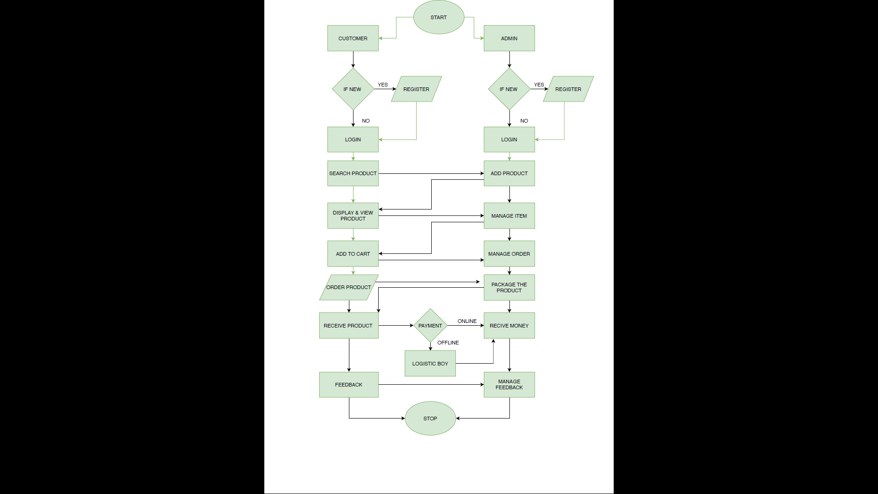
admin

Slide 20
Data flow diagrams

Slide 21
Zero Level DFD
0
Online Shopping System
Admin
Customer

Slide 22
first Level DFD
1.0
Create Account
Login/Registration
Login/Registration
Customer
Admin
Response
Response
2.0
Order
Insert/ Change /update
catalogue
Browse
Purchase Request
Order Request
3.0
Payment
Manage Conformation
Conformation message
Make Payment
Receive Payment

Slide 23
second Level DFD
Customer
Admin
Registration info
1.1
Register
response
information
Registration db
response
Login info
1.2
login
Login info
response
response
Information fetching
response
Login db
Request for password / Update profile
1.3
Forgot pass/ update profile
Request for password / Update profile
response
Response from server
Response from server
product db
Information fetching/editing

Slide 24
customer
request for cart view
Admin
2.1
Add prduct
response
request
Order db
response
2.2
View/select product
Order selection request
Display the selected request
response
response
response
request
Order_con db
response
Order/ cancel the product
2.3
Order/ cancel
Update Dispatch/cancel order
response
request
Order_deliv db
response

Slide 25
customer
Payment method selection
Admin
3.1
View bill
request
Response
Payment db
Response
3.2
Online payment
Send the payment
Receive the payment
request
Payment info
Response

Slide 26
Data Dictionary

Slide 27
Registration Customer
Sr.No | Field Name | Data Type | Size | Key | Description
1 | Id | integer | 20 | PK | Auto increment
2 | name | varchar | 191 | NN | Customer Name
3 | Email | varchar | 191 | NN | Email Id of Customer
4 | user_type | varchar | 191 | NN | Type of Customer
5 | phone | varchar | 191 | NN | Mobile no of Customer
6 | address | varchar | 191 | NN | Customer’s Address
7 | password | varchar | 191 | NN | Password of Customer

Slide 28
Registration Admin
Sr.No | Field Name | Data Type | Size | Key | Description
1 | Id | integer | 20 | PK | Auto increment
2 | name | varchar | 191 | NN | Admin Name
3 | Email | varchar | 191 | NN | Email Id of Admin
4 | user_type | varchar | 191 | NN | Type of Customer (1 for Admin)
5 | phone | varchar | 191 | NN | Mobile no of Admin
6 | address | varchar | 191 | NN | Admin’s Address
7 | password | varchar | 191 | NN | Password of Admin

Slide 29
Admin Login
Sr.No | Field Name | Data Type | Size | Key | Description
1 | id | Integer | 10 | PK | Auto increment
2 | email | varchar | 191 | NN | Admin’s Email
3 | password | varchar | 191 | NN | Password of Admin

Slide 30
Product Table
Sr.No | Field Name | Data Type | Size | Key | Description
1 | id | Integer | 10 | PK | Auto increment
2 | product_name | varchar | 191 | NN | Product’s name
3 | description | varchar | 191 | NN | Product’s Description
4 | catagory | varchar | 200 | NN | Product’s catagory
5 | price | float | predefined | NN | Product’s Price
6 | discount_price | float | predefined | NN | Product’s Discount Price

Slide 31
Cart Details
Sr.No | Field Name | Data Type | Size | Key | Description
1 | id | Integer | 10 | PK | Auto increment
2 | name | varchar | 191 | NN | Customer Name
3 | email | varchar | 191 | NN | Customer’s email
4 | P_id | Integer | 10 | FK | Product’s Id
5 | phone | varchar | 191 | NN | Customers’s Mobile
6 | product_name | varchar | 191 | NN | Product’s Name
7 | price | float | predefine | NN | Product’s Price
8 | user_id | int | 10 | UK | User’s Id

Slide 32
Order Details
Sr.No | Field Name | Data Type | Size | Key | Description
1 | Order_id | Integer | 10 | PK | Auto increment
2 | Cart_id | Integer | 10 | FK | Carts’s Id
3 | Total_amount | varchar | 12 | NN | Total Amount to be paid
4 | Date_of_Purchase | date | predefined | NN | Date of order

Slide 33
Payment
Sr.No | Field Name | Data Type | Size | Key | Description
1 | Payment_id | Integer | 10 | PK | Auto increment
2 | Order_id | Integer | 10 | FK | Order Id
3 | Pay_date | date | predefined | NN | Date of payment
4 | Pay_mode | varchar | 25 | NN | Mode of payment
5 | Pay_amount | float | Prededined | NN | Amount to be paid

Slide 34
Detailed Process of Proposed system (Field & screens)

Slide 35
Screenshots of main modules CUSTOMER

Slide 36

Home page

Slide 37
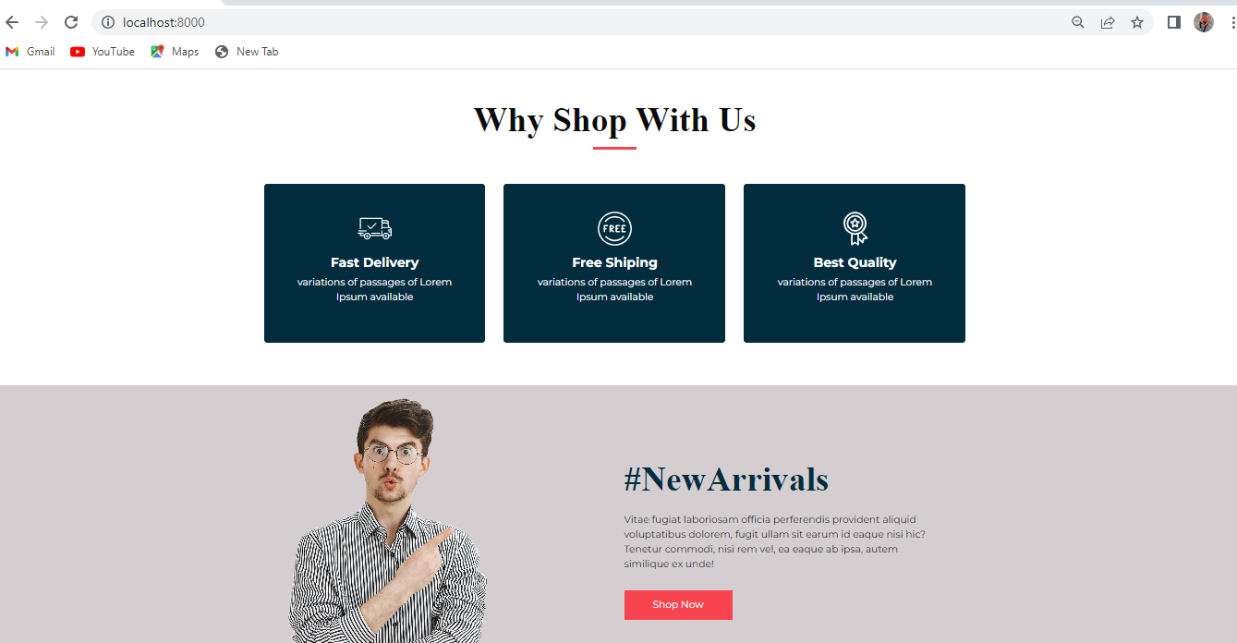
Scrolled homepage

Slide 38
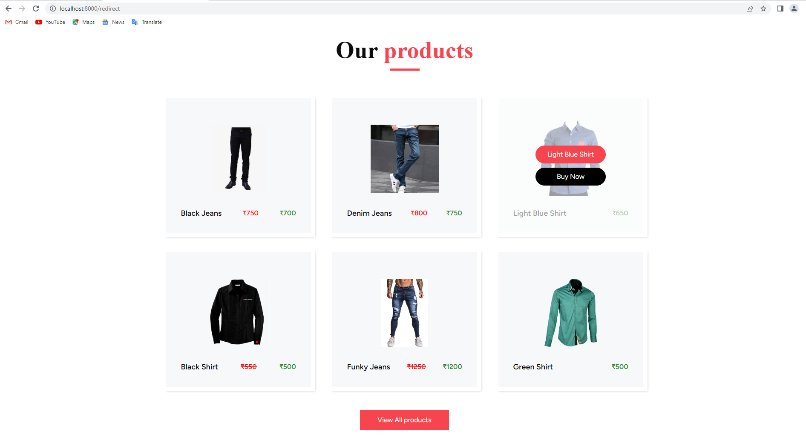
Product page

Slide 39
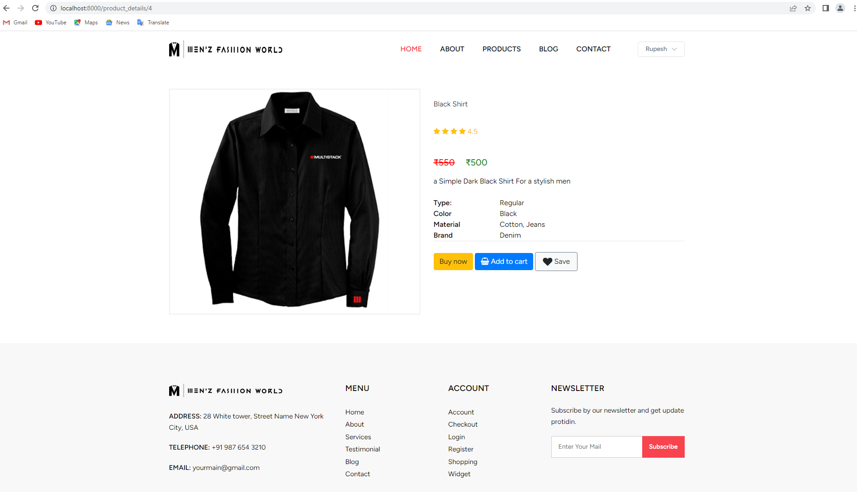
Selected product page

Slide 40
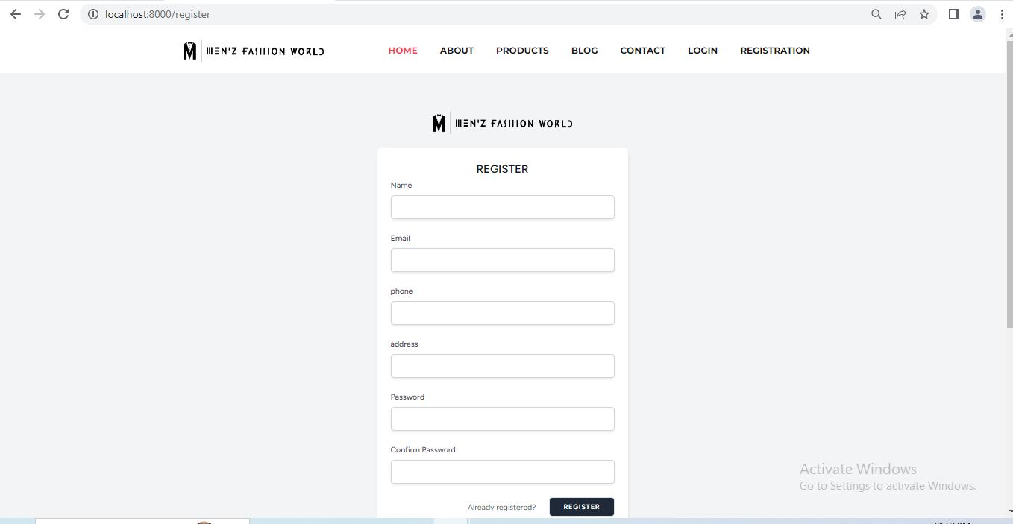
Registration page

Slide 41
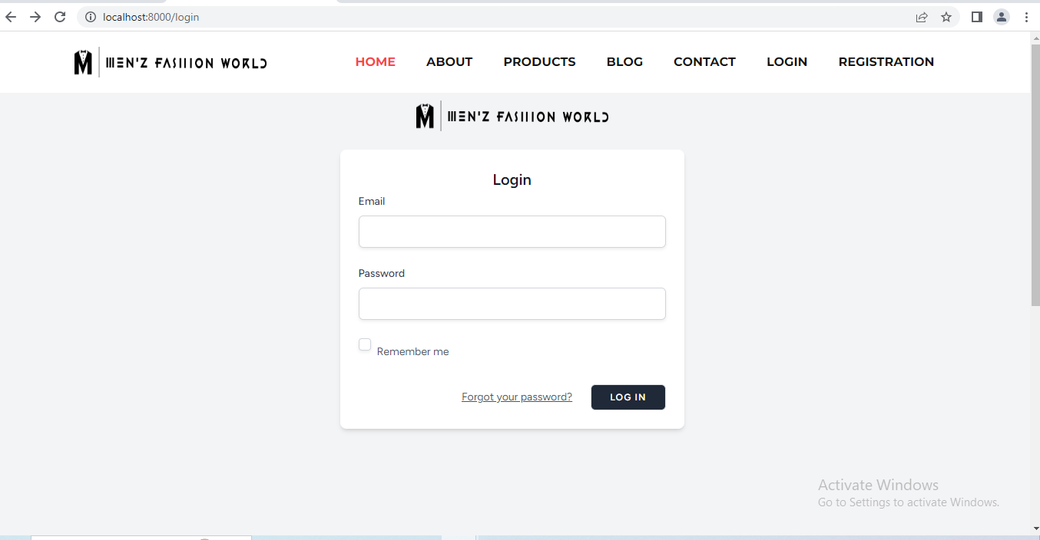
Login Page

Slide 42
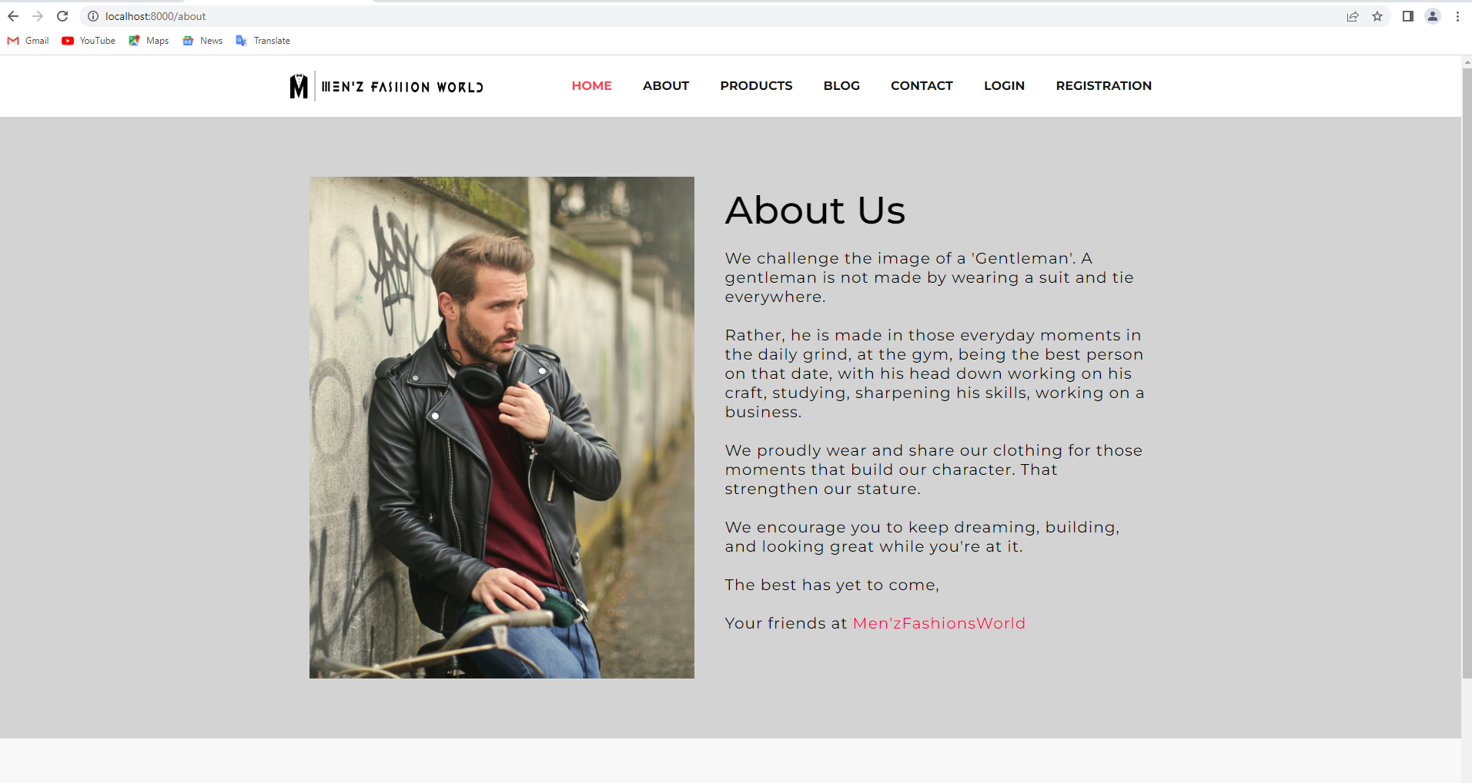
About us page

Slide 43
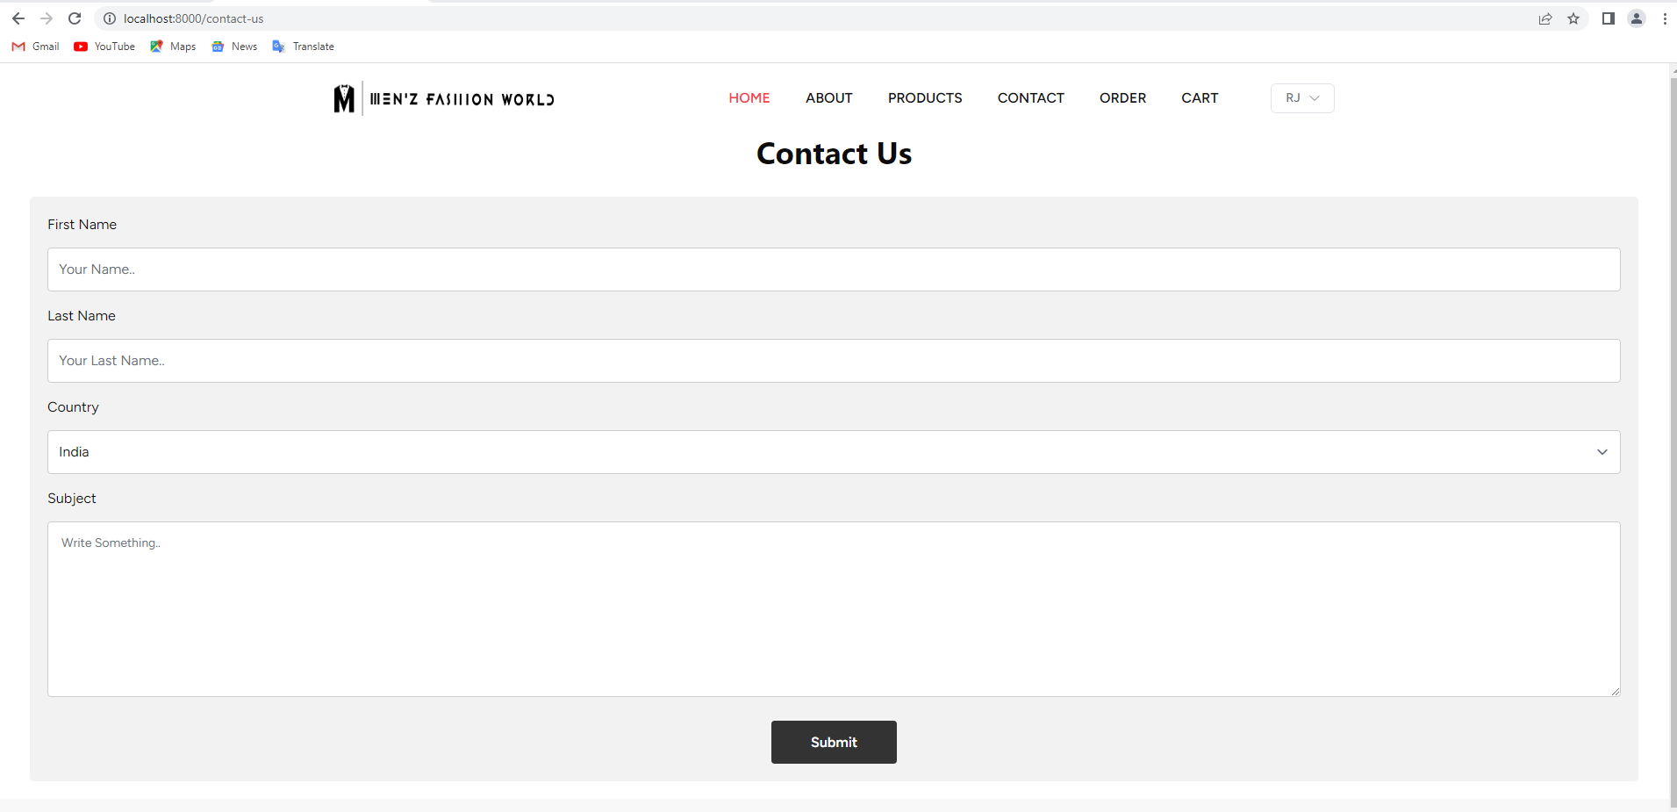
Contact-us page

Slide 44
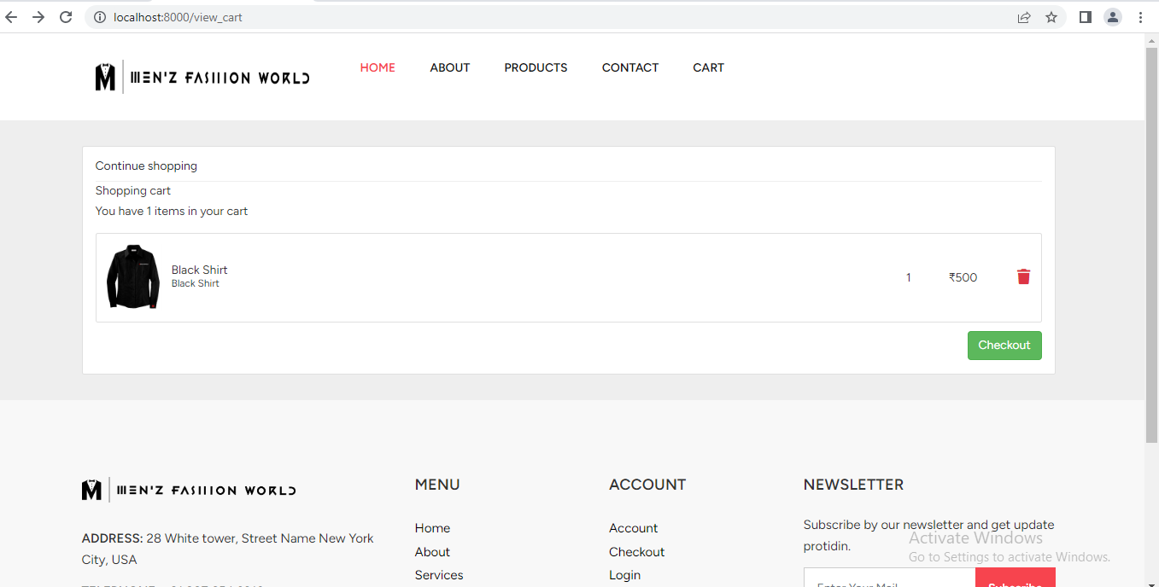
CART PAGE

Slide 45
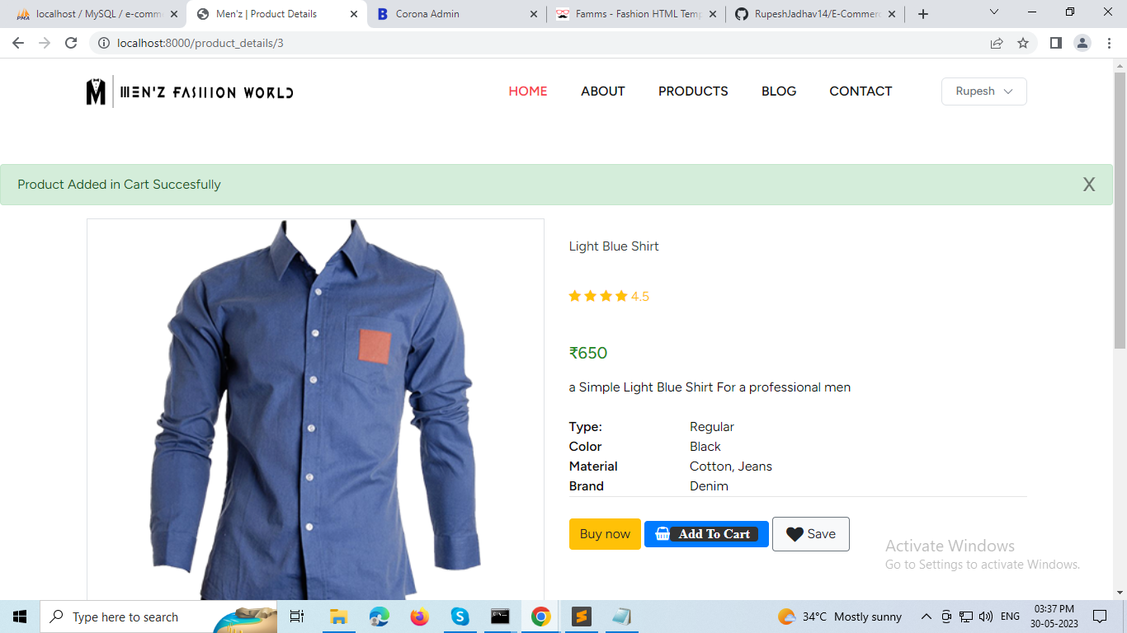
Added in cart

Slide 46
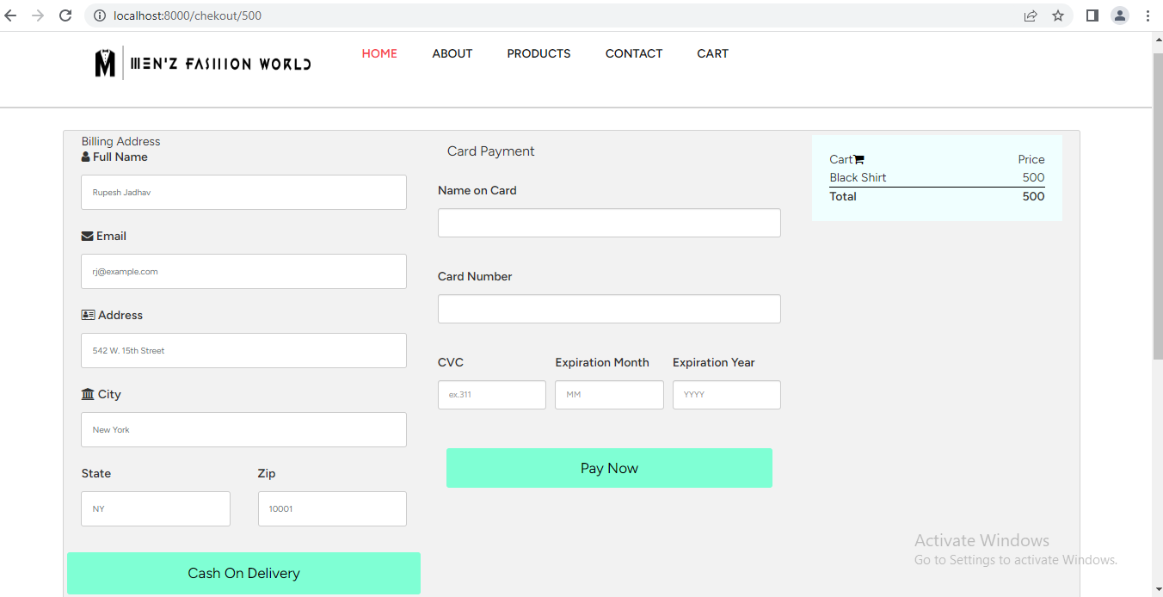
Checkout page

Slide 47
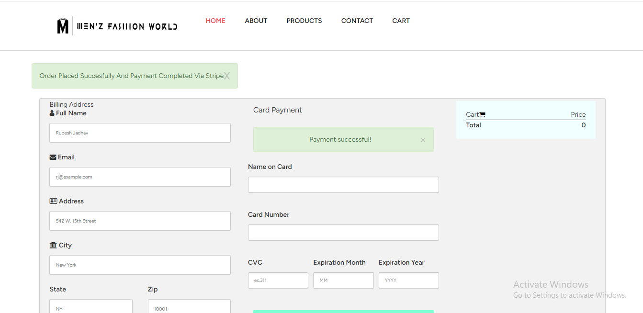
Payment succesful

Slide 48
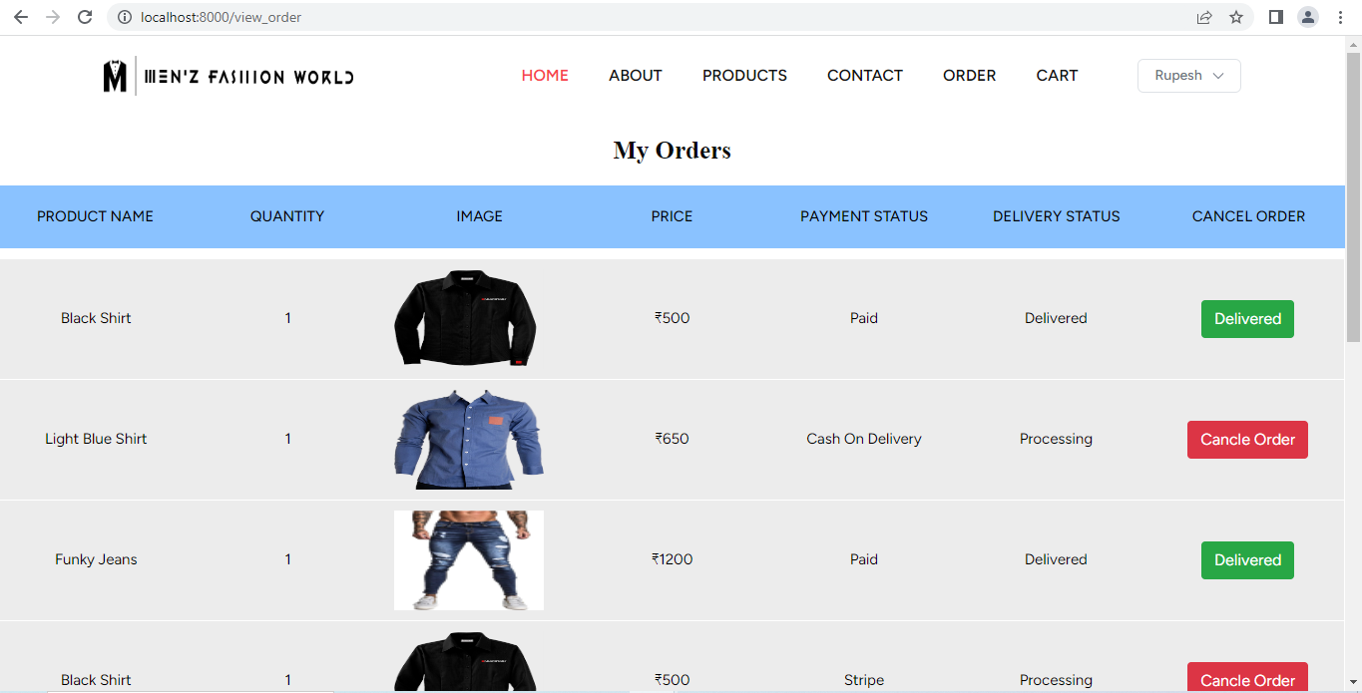
My Orders Page

Slide 49
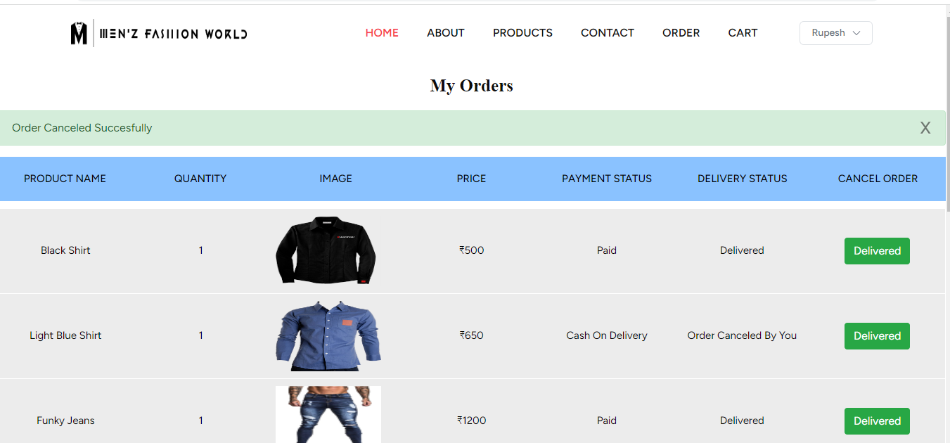
Order Cancel

Slide 50
ADMIN

Slide 51
Admin Login

Slide 52
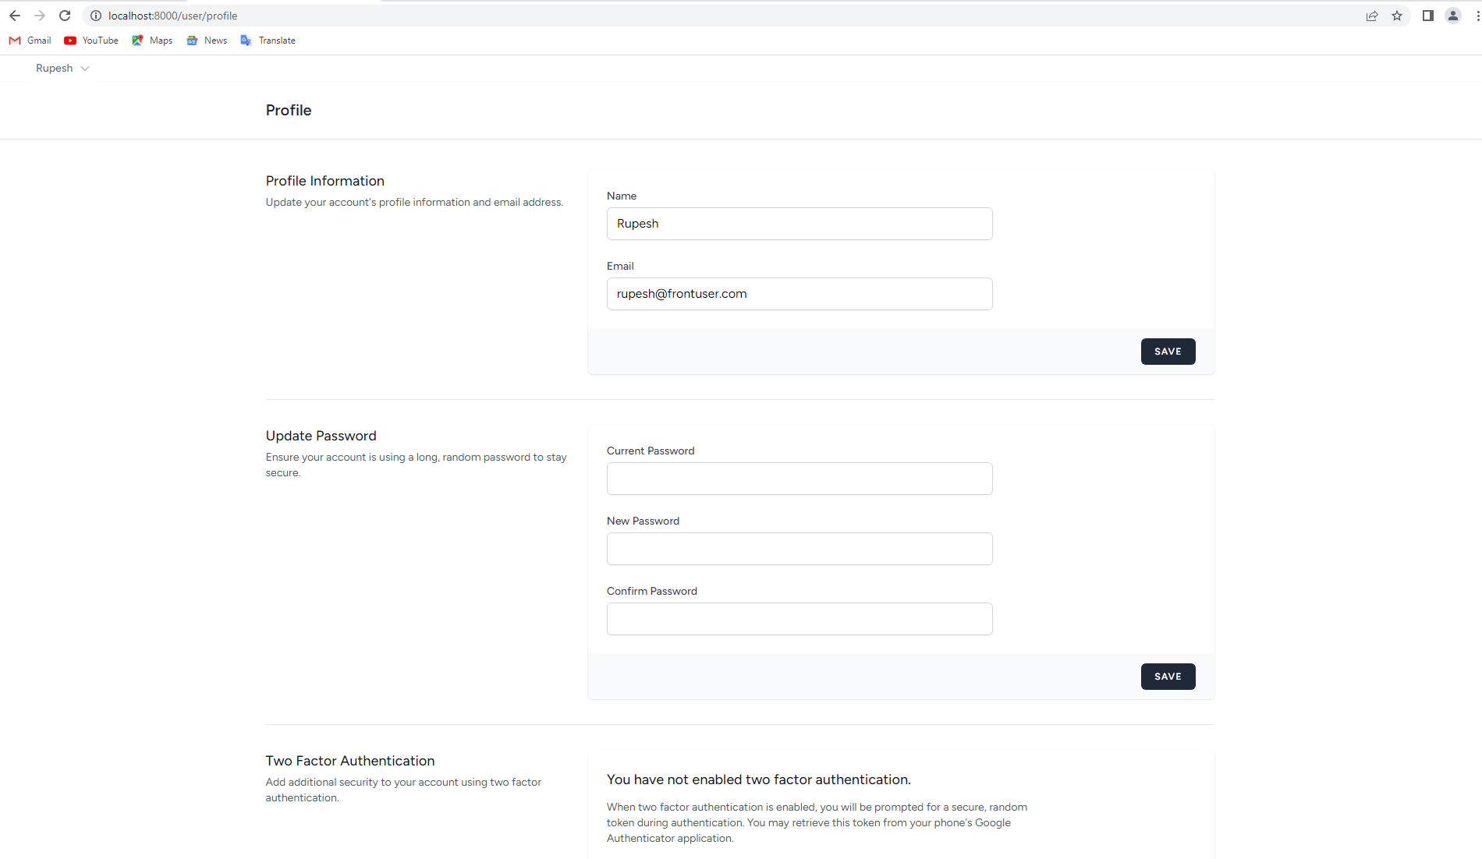
Manage profile

Slide 53
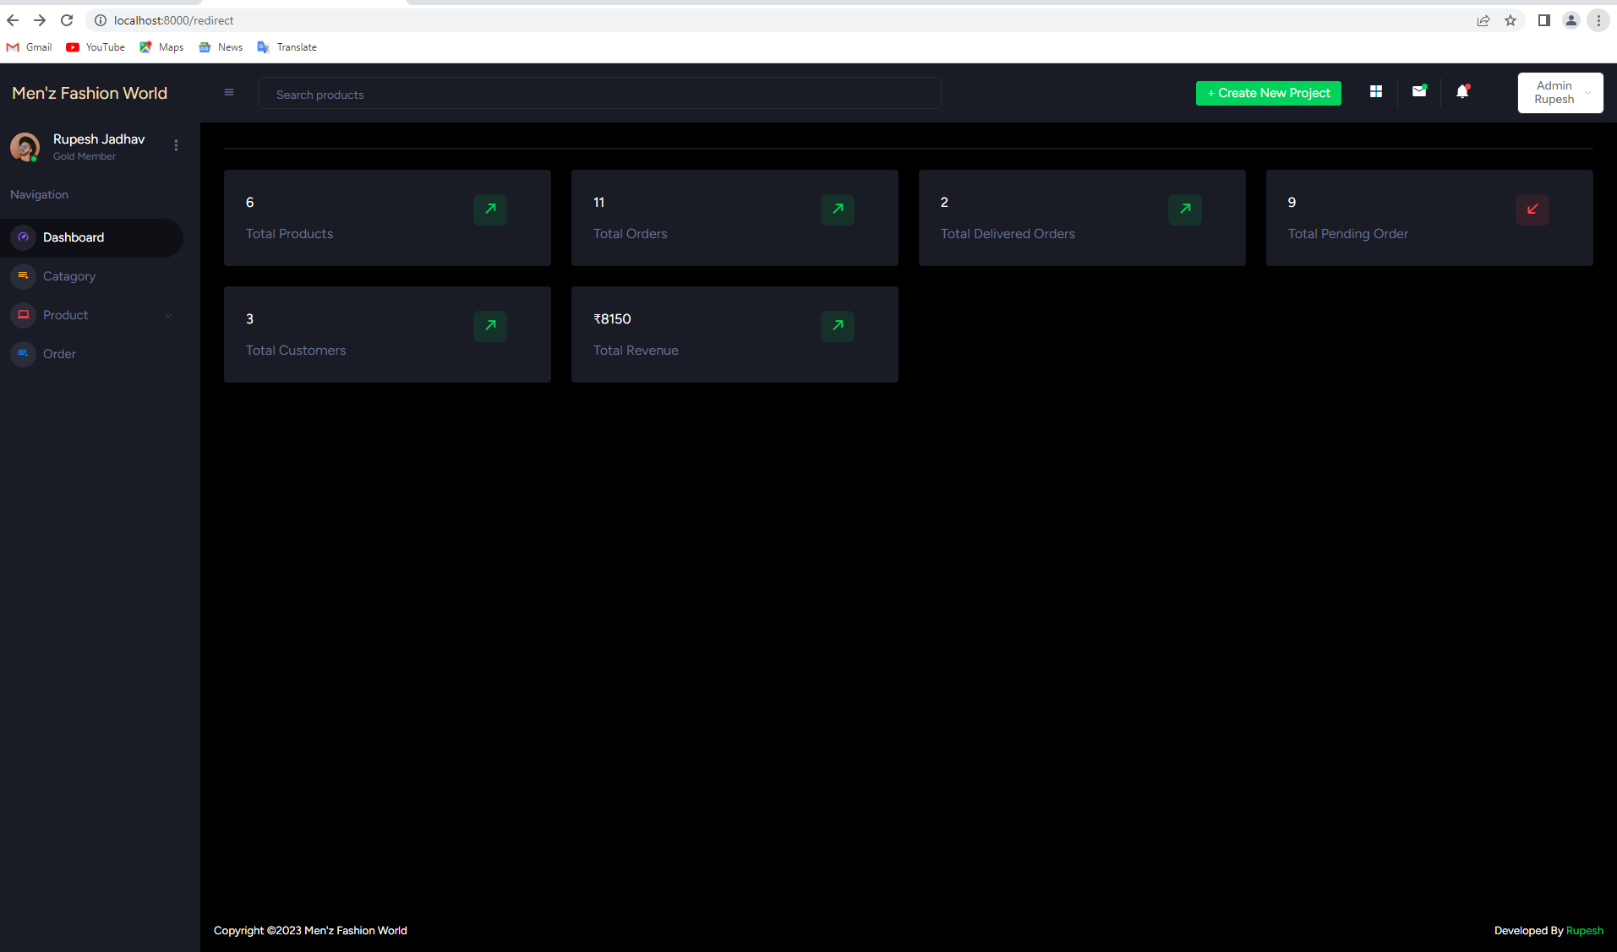
Admin Dashboard

Slide 54
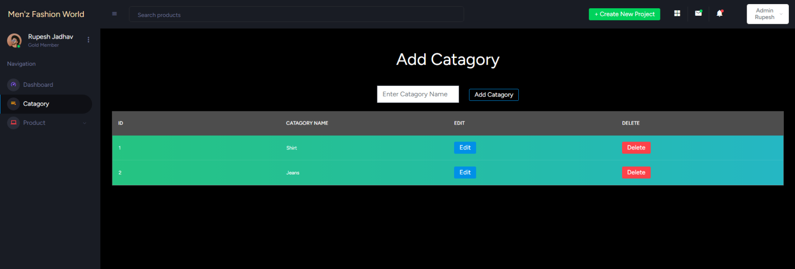
Add category

Slide 55
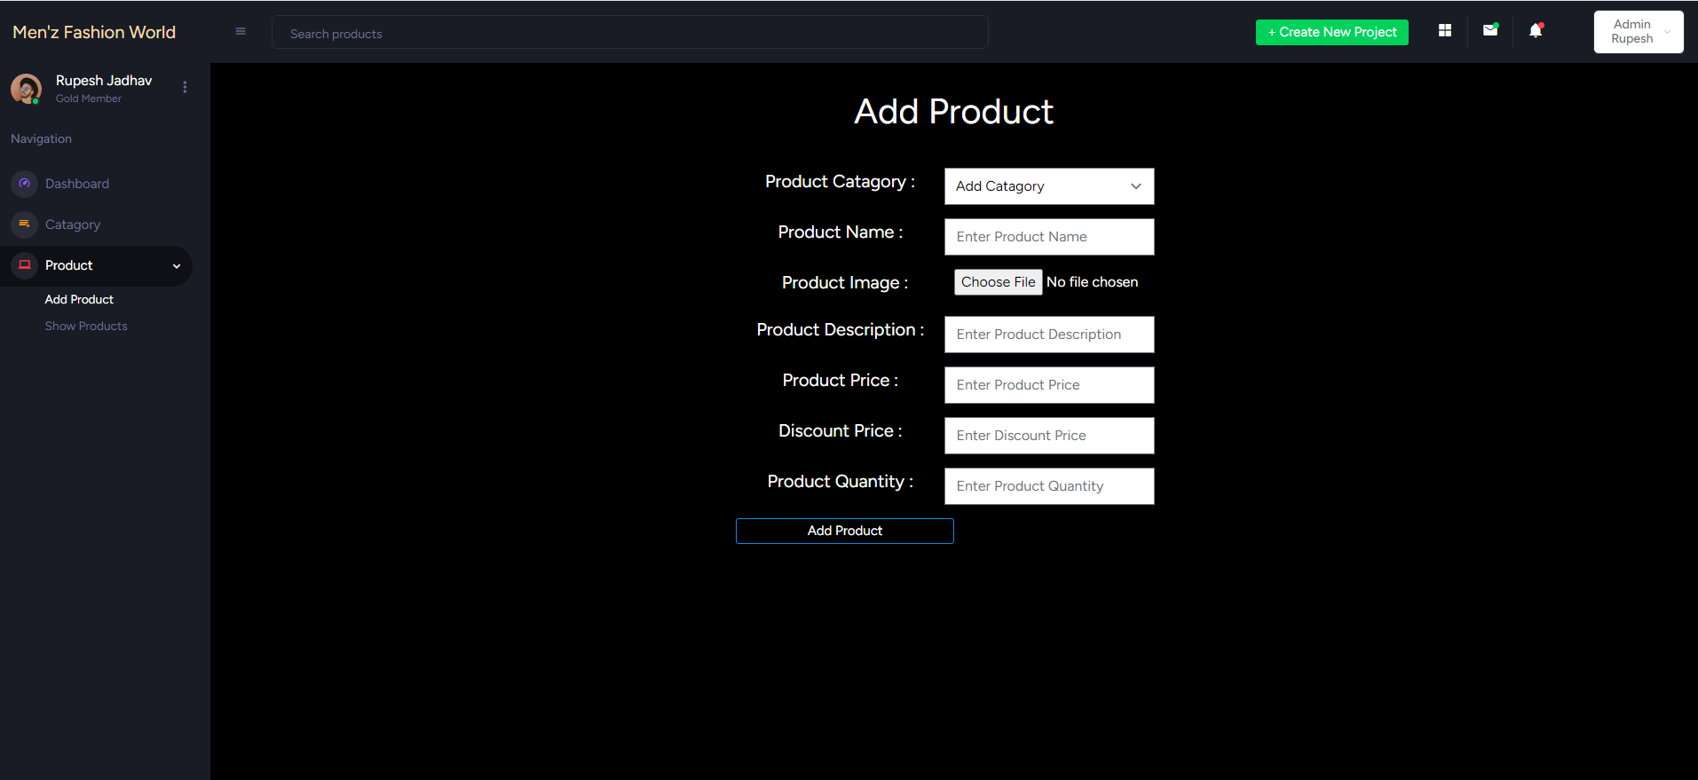
Add Product

Slide 56
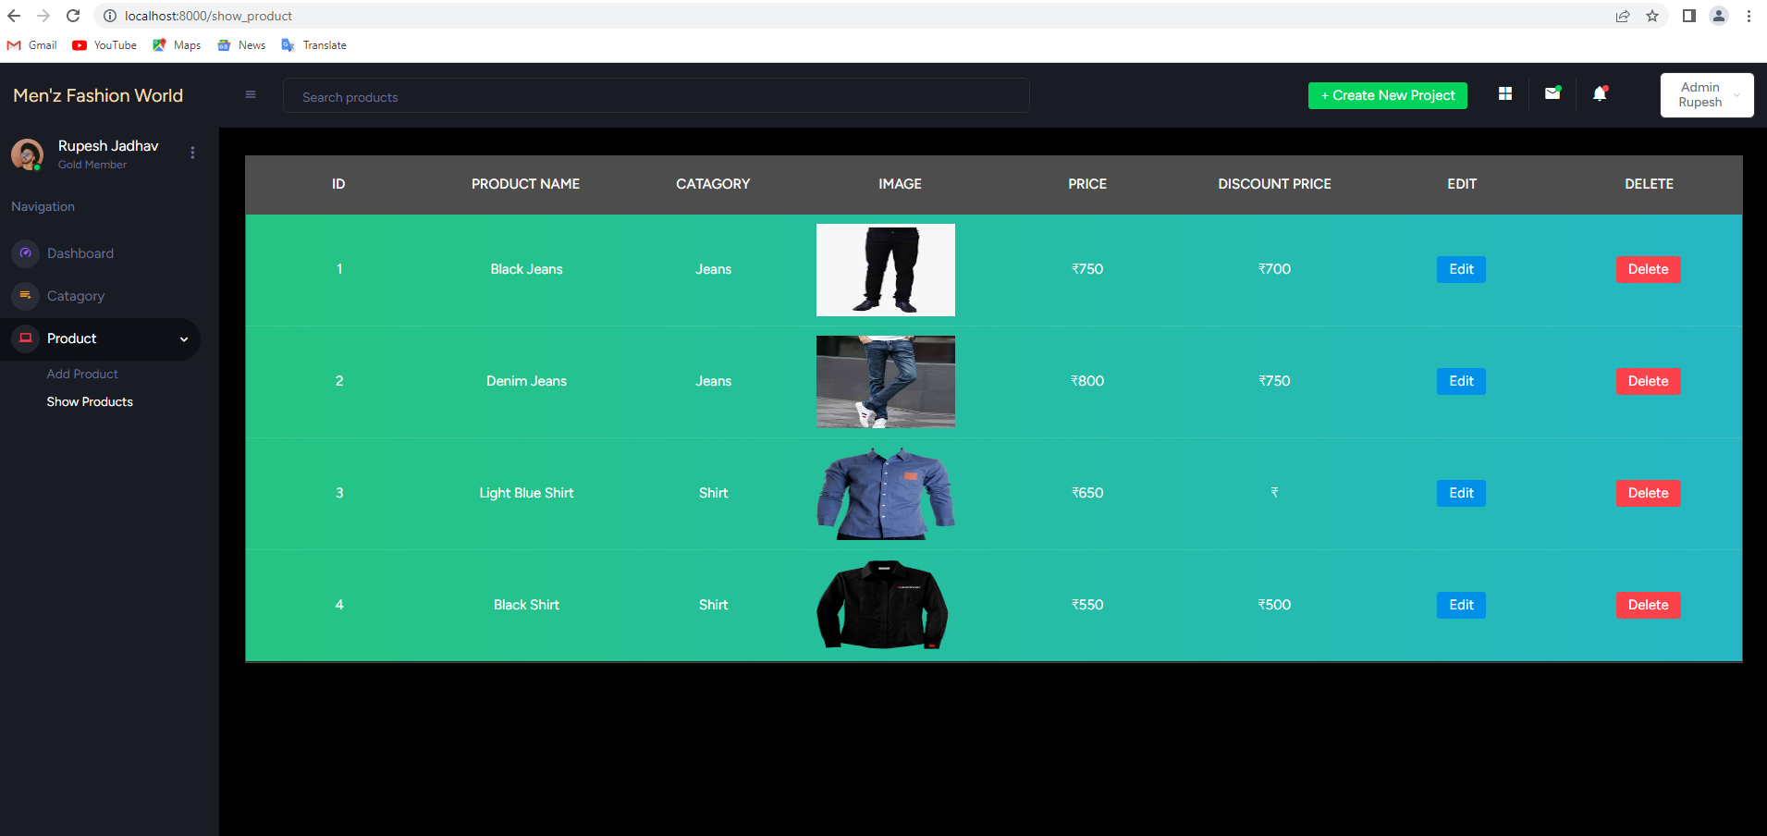
Product’s Listing Admin

Slide 57
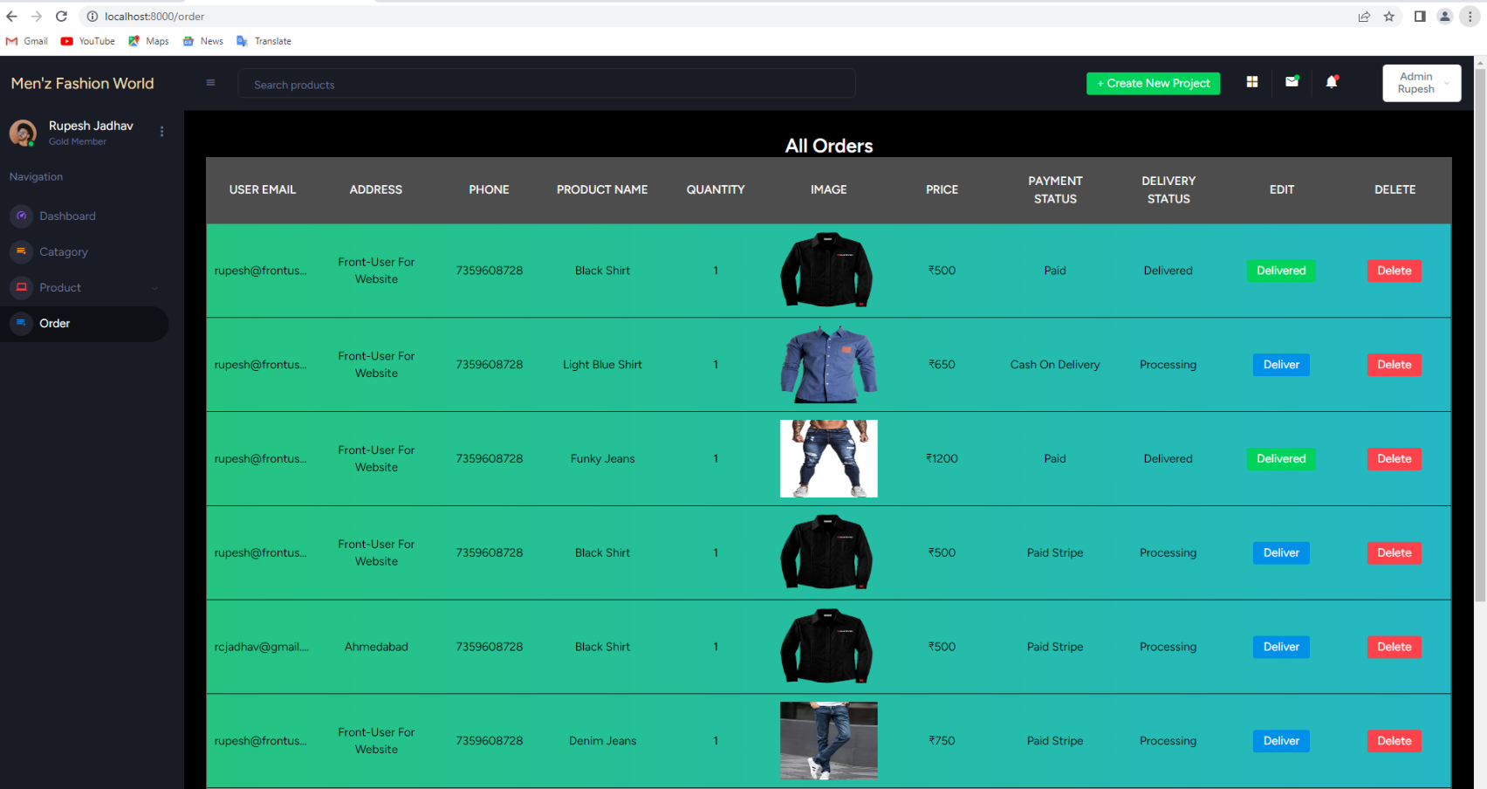
order Listing Admin side

Slide 58
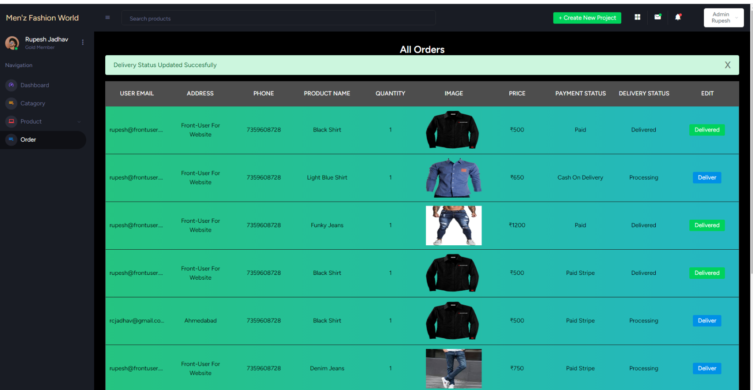
Delivery status update

Slide 59
Technology Selected for Proposed System
HTML
Java script
CSS
Language :- PHP
Framework :- Laravel
Data Base :- MYSQL

Slide 60

Thank You
Rupesh Jadhav
Mohit Jain
Kashyap Prajapati

